Slide 1
Eclipse Plug-in Development
Introduction of Development Tools
JDT and PDE

Slide 2
Contents
JDT - Java Development Tooling
  Java Model
  Type Hierarchy
  Search Engine
PDE - Plug-in Development Environment
  UI
  API Tools
  Build

Slide 3
JDT
Java Model – Lightweight model for views
  OK to keep references to it
  Contains unresolved information
  From projects to declarations (types, methods, …)

Slide 4
JDT
Java Model – Lightweight model for views
  Java model and its elements
  Classpath elements
  Java project settings
  Creating a Java element
  Change notification
  Type hierarchy
  Code resolve

Slide 5
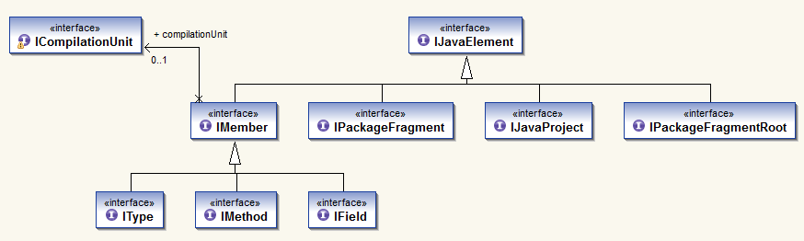
Java Model
Java Elements API

Slide 6
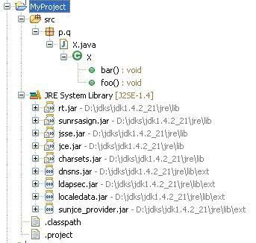
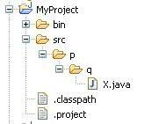
Java Model
Java Elements API
IJavaProject
IPackageFragmentRoot
JavaCore.create(resource)
IPackageFragment
IType
ICompilationUnit / IClassFile
IMethod IField IInitialzier
element.getParent()
IProject
IFolder
IFile
element.getChildren()
javaElement.getResource()

Slide 7
Java Model
Using the Java Model
  Setting up Java project
  Java nature
  Java builder
  Java class path
IWorkspaceRoot root = ResourcesPlugin.getWorkspace().getRoot();
IProject project = root.getProject(projectName);
project.create(null);
project.open(null);
IProjectDescription description = project.getDescription();
description.setNatureIds(new String[] { JavaCore.NATURE_ID });
project.setDescription(description, null);
IJavaProject javaProject = JavaCore.create(project);
IClasspathEntry[] classPath = new IClasspathEntry[0];
// define class path here
IPath defaultOutputLocation = null;
javaProject.setRawClasspath(classPath, defaultOutputLocation, null);

Slide 8
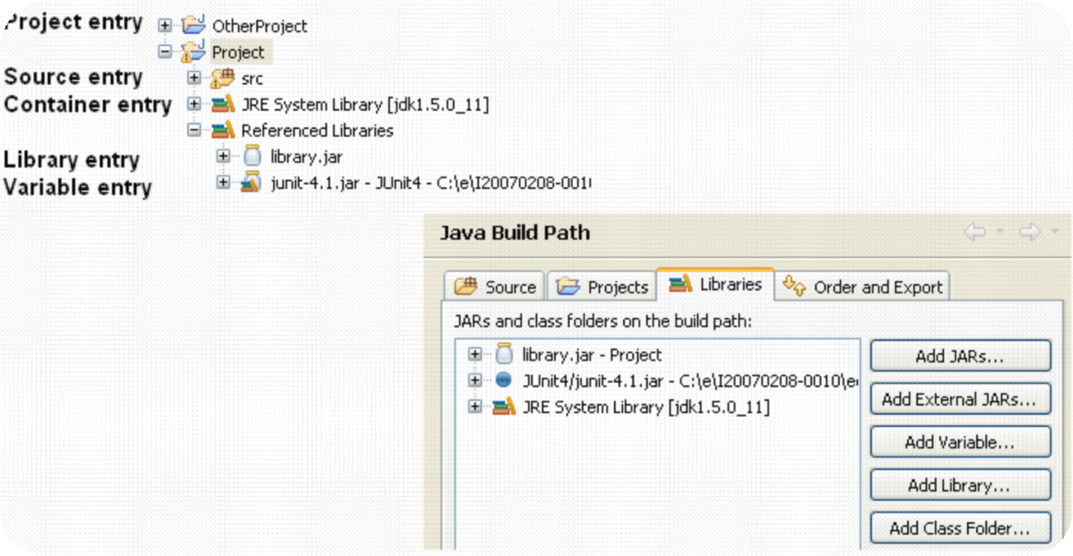
Java Model
Java class path
  The Java element hierarchy is defined by the Java classpath
  Classpath entries define the roots of package fragments

Slide 9
Java Model
Classpath
  Source entry: Java source files to be built by the compiler
    Folder inside the project or the project itself
    Possibility to define inclusion and exclusion filters
    Compiled files go to either a specific or the projects default output location
  Library entry: Class folder or archive
    Class files in folder or JAR archive, in workspace or external
    Source Attachment specifies location of library’s source
IPath srcPath = javaProject.getPath().append("src");
IPath[] excluded = new IPath[] { new Path("doc") };
IClasspathEntry srcEntry = JavaCore.newSourceEntry(srcPath,
excluded);
IClasspathEntry libEntry = JavaCore.newLibraryEntry( new Path("d:/lib/foo.jar"), // library location
new Path("d:/lib/foo_src.zip"), // source archive location new Path("src"), // source archive root
true); // exported

Slide 10
Java Model
Creating Java Elements
Java project
IJavaProject javaProject = JavaCore.create(project);
IClasspathEntry[] buildPath = {
JavaCore.newSourceEntry(project.getFullPath().append("src")),
JavaRuntime.getDefaultJREContainerEntry() };
javaProject.setRawClasspath(buildPath, project.getFullPath().append("bin"), null);
Source folder
IFolder folder = project.getFolder("src");// Create the source folder
folder.create(true, true, null);
IPackageFragmentRoot srcFolder = javaProject.getPackageFragmentRoot(folder);
Assert.assertTrue(srcFolder.exists()); // resource exists and is on build path
Package
IPackageFragment fragment= srcFolder.createPackageFragment("x.y", true, null);
Create compilation unit
String str = "package x.y;" + "\n"
+ "public class E {" + "\n"
+ " String first;" + "\n"
+ "}";
ICompilationUnit cu = fragment.createCompilationUnit("E.java", str, false, null);
Create a field
IType type= cu.getType("E");
type.createField("String name;", null, true, null);

Slide 11
Java Model
JavaCore.addElementChangedListener(new IElementChangedListener() {
  public void elementChanged(ElementChangedEvent event) {
  boolean res = hasTypeAddedOrRemoved(event.getDelta());
  }
  private boolean hasTypeAddedOrRemoved(IJavaElementDelta delta)
  IJavaElement elem = delta.getElement();
  boolean isAddedOrRemoved = (delta.getKind() != IJavaElementDelta.CHANGED);
  switch (elem.getElementType()) {
  case IJavaElement.JAVA_MODEL:
  case IJavaElement.JAVA_PROJECT:
  case IJavaElement.PACKAGE_FRAGMENT_ROOT:
  case IJavaElement.PACKAGE_FRAGMENT:
  if (isAddedOrRemoved)
  return true;
  return processChildrenDelta(delta.getAffectedChildren());
  case IJavaElement.COMPILATION_UNIT:
  ICompilationUnit cu = (ICompilationUnit) elem;
  if (!cu.getPrimary().equals(cu))
  return false;
  if (isAddedOrRemoved|| isPossibleStructuralChange(delta.getFlags()))
  return true;
  return processChildrenDelta(delta.getAffectedChildren());
  case IJavaElement.TYPE:
  if (isAddedOrRemoved)
  return true;
  return processChildrenDelta(delta.getAffectedChildren()); // inner types
  default: // fields, methods, imports...
  return false;
  }
  }
});
Change notification

Slide 12
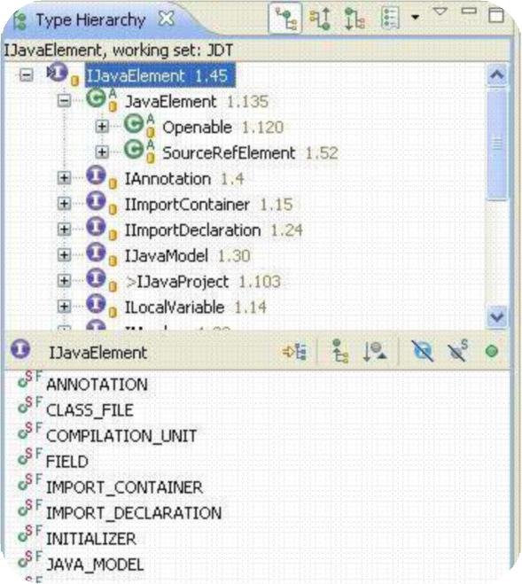
Java Model
Type Hierarchy
  Snapshot of ITypes in a sub/super type relationship
  Used in Type Hierarchy view

Slide 13
Java Model
Type Hierarchy
Create – on a type or on a region (= set of Java Elements)
typeHierarchy= type.newTypeHierarchy(progressMonitor);
typeHierarchy= project.newTypeHierarchy(region, progressMonitor);
Supertype hierarchy – faster!
typeHierarchy= type.newSupertypeHierarchy(progressMonitor);
Get super and subtypes, interfaces and classes
typeHierarchy.getSubtypes(type)
Change listener – when changed, refresh is required
typeHierarchy.addTypeHierarchyChangedListener(..);
typeHierarchy.refresh(progressMonitor);

Slide 14
Java Model
Code resolve
  Resolve the element at the given offset and length in the source
    javaElements= compilationUnit.codeSelect(50, 10);
  Used for Navigate > Open (F3) and tool tips

Slide 15
Java Model
More Java Model Features
  Navigation – resolve a name
    IType type= javaProject.findType("java.util.Vector");
  Context – resolve an enclosing element
    element= compilationUnit.getElementAt(position);
  Code assist – evaluate completions for a given offset
    compilationUnit.codeComplete(offset, resultRequestor);
  Code formatting
    ToolFactory.createCodeFormatter(options) .format(kind, string, offset, length, indentationLevel, lineSeparator);

Slide 16
API in JDT UI
Labels, images, structure, order for IJavaElements
  JavaElementLabelProvider
  StandardJavaElementContentProvider
  JavaElementComparator
Selection and configuration dialogs, wizards
  JavaUI.createPackageDialog(…), JavaUI.createTypeDialog(…)
  BuildPathDialogAccess
  NewClassWizardPage, NewInterfaceWizardPage…
  JavadocExportWizardPage, NewJavaProjectWizardPageOne/Two
Java Actions to add to context menus
  package org.eclipse.jdt.ui.actions

Slide 17
JDT
Search for declarations and references
  packages, types, fields, methods and constructors
  using wildcards (including camel-case) or from a Java element
Scoped search
  region = set of Java elements
  predefined workspace and hierarchy scopes
Potential matches
  Code with errors, incomplete class paths
Limit the match locations
  in casts, in catch clauses, only return types…

Slide 18
PDE
UI
  Form-Based Manifest Editors
  RCP Tools
  New Project Creation Wizards
  Import Wizards
  Export Wizards
  Launchers – Test and debug Eclipse applications and OSGi bundles
  Views
  Miscellaneous Tools – Wizard to externalize and clean up manifest files
  Conversion Tools – Wizard to convert java project to plug-in project
  Integration with JDT - Plug-in manifest files participate in Java search and refactoring.

Slide 19
PDE
Tools
  Compatibility Analysis
    Identify binary compatibility issues relative to a previous version of a plug-in.
  API Restriction Tags
    Javadoc tags are provided to explicitly define restrictions associated with types and members.
  Version Number Validation
    Identify invalid plug-in version numbers relative to a previous version of a plug-in.
  Javadoc @since Tag Validation
    Identify missing and invalid @since tags on types and members.
  API Leak Analysis
    Identify API types and methods that leak non-API types.
  Quick Fixes
    Quick fixes are provided to adjust plug-in versions and @since tags appropriately.

Slide 20
PDE
Build
  Automated building of RCP applications from product configurations
  Automated building of features
  Automated building of plug-ins
  Generating Ant scripts from PDE
  Generating Ant scripts from scripts
  Building p2 repositories and products
  Builder Configuration Properties
  Feature and Plug-in build properties

Slide 21
Any Questions?
Skype: jin.liu.soyatec
Email: jin.liu@soyatec.com

Slide 22
The end

